Slide 1







Enhancing Metaphor Detection on word pairs
Presented by FANG, Yaoran Lin, Duanhui GAO, Zhuocheng

Slide 2


Today's Agenda
1
Model and dataset
2
Methods
3
Results and Insights

Slide 3


Goal
We finetuned the DistilBERT model to make it better in Metaphor detections.

Slide 4
Why use DistillBert?
Light weight: DistilBERT is a lightweight model based on the BERT model, which has similar principles to BERT but differs in model structure and training methods.
Performance: DistilBERT uses a technique called "knowledge distillation" to transfer pre-trained knowledge from BERT to DistilBERT, allowing DistilBERT to achieve performance similar to BERT with fewer computational resources.
Suitability: "Encoder-only" models like BERT are designed to produce a single prediction per input token or a single prediction for an entire input sequence. This makes them applicable for text classification.

Slide 5




DateSet
Metaphor datasets
Jankowiak Dataset
Pair instances: The primary structure of each instance is a pair of nouns (A and B)
within a sentence, mostly formatted as "A is a B." These sentences exhibit different levels of metaphorical expression.
It contains 120 sets of triples with
"A is-a/is-like-a B" sentences. Each set contains one literal, one semantically abnormal, and one metaphorical expression. The labels (0, 1, 2) denote the degree of metaphorical usage, ranging from anomaly , literal, and metaphor.

Slide 6
Examples
Anomaly: This refers to language that is unexpected or does not fit within a particular context or category. “A car is a banana.”
Literal: This refers to language that is used in a straightforward, factual manner without any figurative or metaphorical meaning. “A car is a vehicle:”
Metaphor: This refers to language that uses a figure of speech to describe something in a non-literal way. “A car is a metal horse.”

Slide 7
Methods
AutoModelForSequenceClassification
Fully connected layer (linear transformation plus activation function) for classification.
The softmax function to convert the output into a probability distribution
Create a tokenizer from a pre-trained checkpoint
Define a tokenization function for truncating the input text
Tokenize the dataset

Slide 8


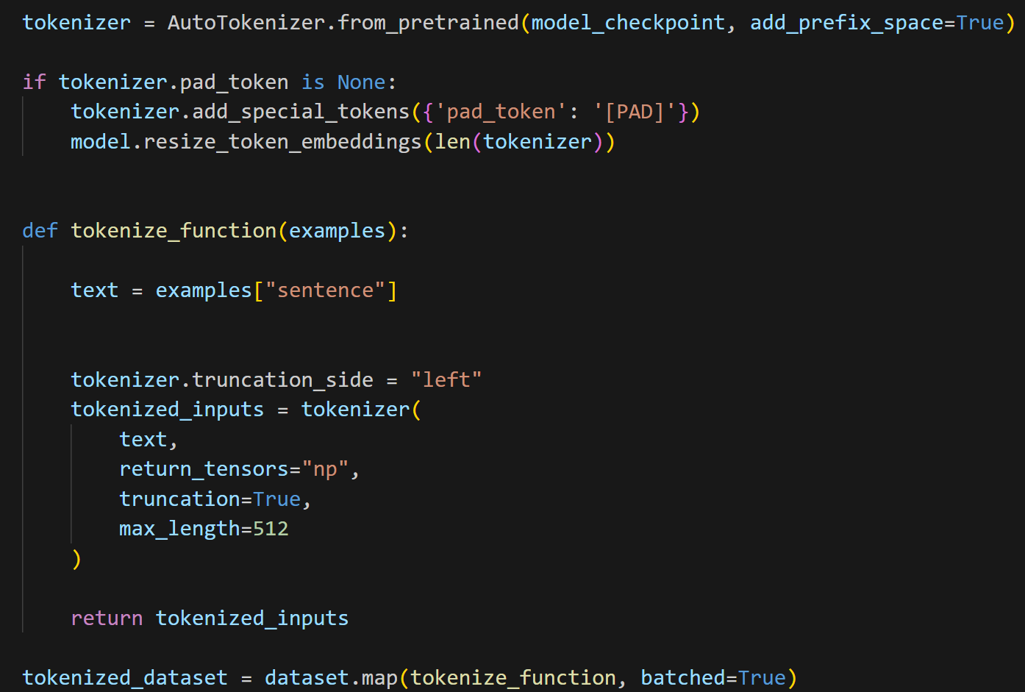
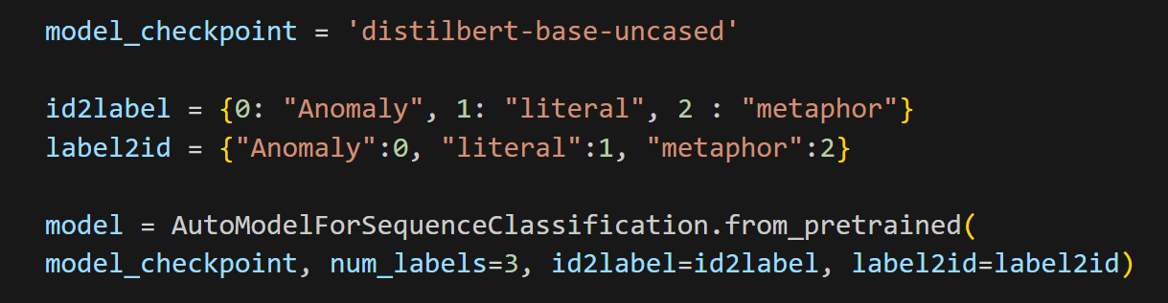
Examples

Slide 9
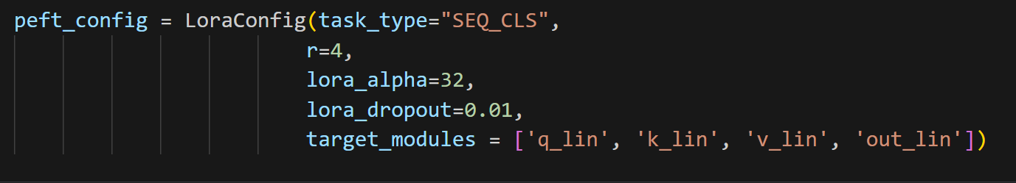
Parameter Efficient Fine-Tuning (PEFT)
Freezing a portion of the parameters in the pre-trained model and only fine-tuning a small subset of the parameters.

Slide 10
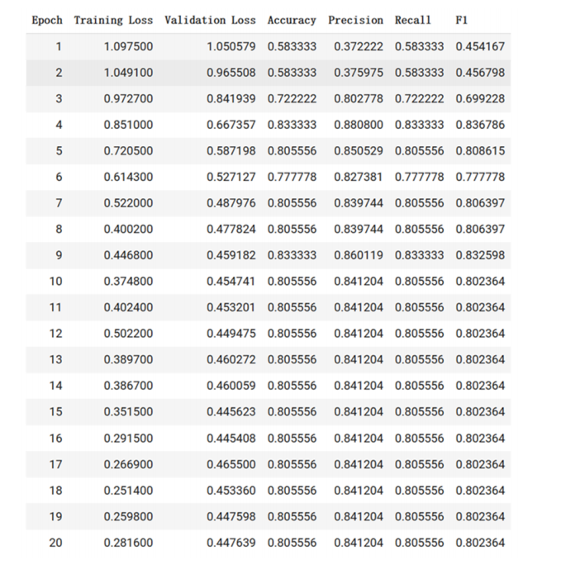
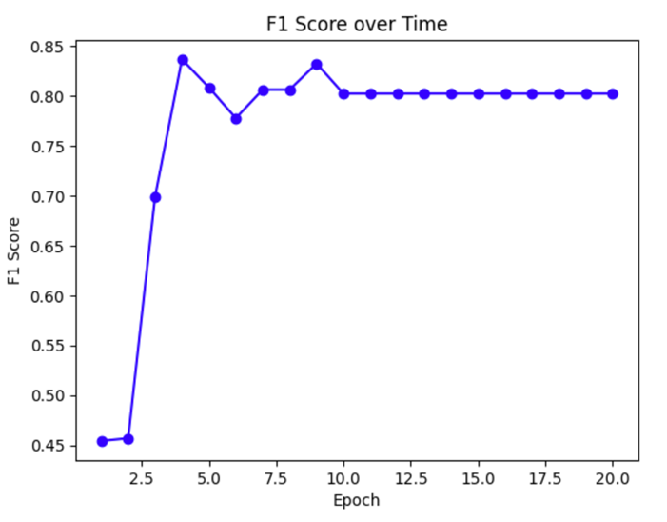
Result

Slide 11
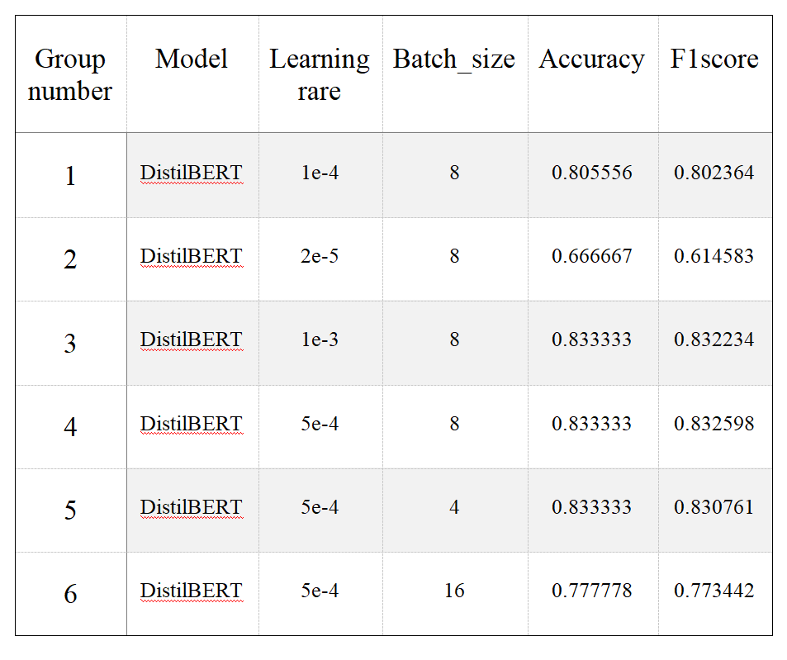
Insights
During training, the settings of the two hyperparameters, learning rate and batch size, have a significant impact on the performance of the model. If they are set too small or too large, it may result in adverse effects.
Therefore, we conducted multiple experiments based on the first group of experiments to find suitable hyperparameter settings, and the results are shown in the table below.

Slide 12
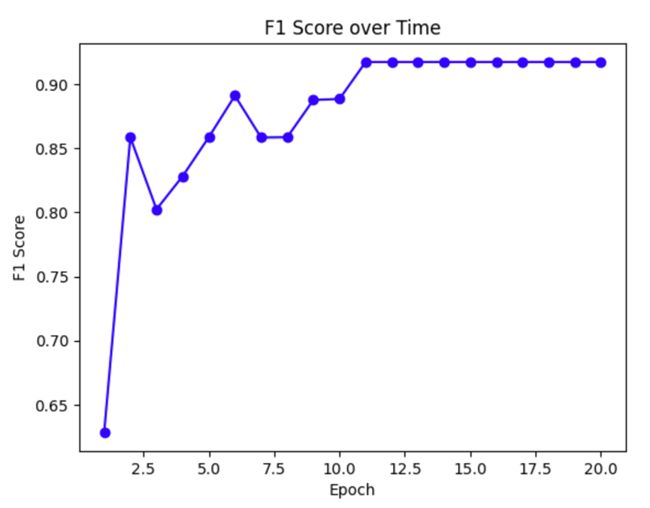
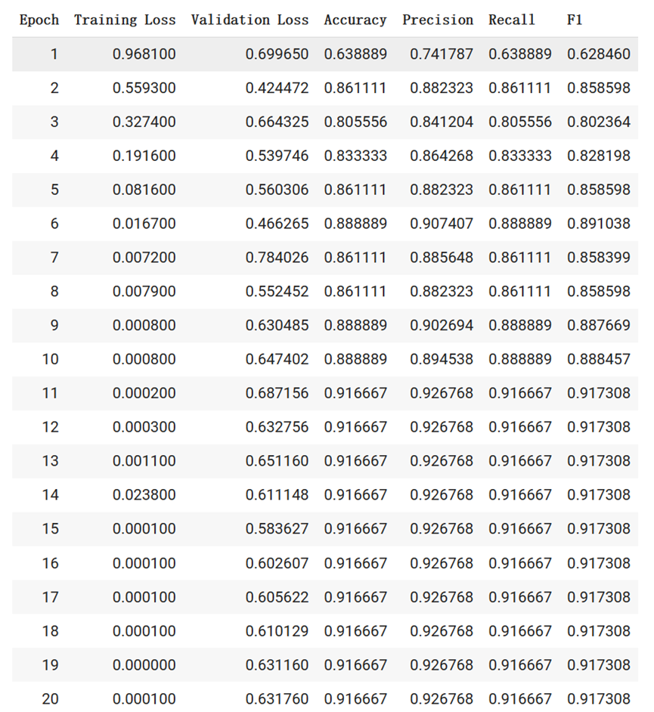
Insights
The experiment found that for the DistilBERT model, multiple hyperparameters can be fine-tuned simultaneously to achieve better model classification performance.

Slide 13
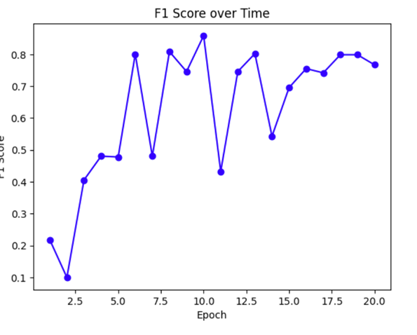
Insights
The performance of the model trained using RoBERTa is not good, and the evaluation metrics fluctuate greatly during the training process, making it unstable.
Possible explanations: DistilBERT is a smaller and faster version of BERT, which means it has fewer parameters and is more computationally efficient. This can make it easier to fine-tune on smaller datasets.

Slide 14
THANK YOU

